Slide 1
ALGORITHMIC DIFFERENTIATION
BITS F276 – Design Oriented Project
28/4/16

Slide 2
INTRODUCTION
Traditional Approaches
Symbolic Differentiation
Method of Finite Differences
Complex Taylor Series Expansion

Slide 3
ALGORITHMIC DIFFERENTIATION
AD works on the principle of Chain Rule at the operator level.
We need,

Slide 4
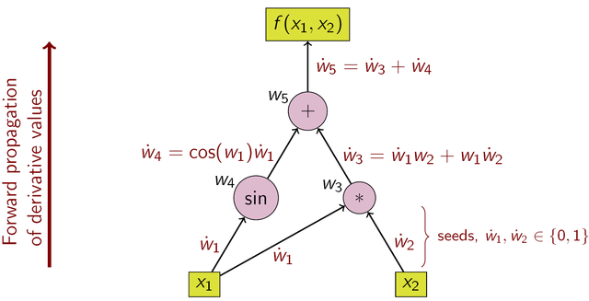
FORWARD MODE
Forward Mode refers to the forward accumulation of the gradient information. i.e. right to left traversal of the chain rule.

Slide 5
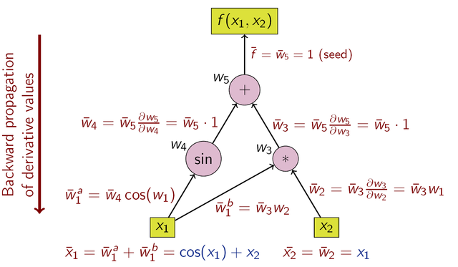
REVERSE MODE
Reverse mode refers to the reverse accumulation of the gradients. I.e right to left traversal of the chain rule.

Slide 6
COMPARISON OF MODES
Forward Mode requires n passes to evaluate the derivative whereas Reverse Mode requires m passes. Therefore, for m >> n, Reverse Mode is preferred and Forward Mode for n >> m.
Criteria to be considered:
Complexity
Memory
The problem of computing a full Jacobian of with a minimum number of arithmetic operations is known as the optimal Jacobian accumulation (OJA) problem, which is NP-complete under mild assumptions.

Slide 7
COMPUTATIONAL GRAPHS
Definition:
G(F) = (V, E)
V = { V_{x}, V_{y}, V_{z}}
V_{x} : set of vertices representing independent variables.
V_{y}: set of vertices representing intermediate variables.
V_{y}: set of vertices representing output varibales.

Slide 8
GRAPH OPTIMISATION
F
F
sin(X₁/X₂)
e^{X1/X2}
sin(X₁/X₂)
e^{X1/X2}
X₁/X₂
X₁/X₂
X₁/X₂
x₁
x₂
x₁
x₂

Slide 9
GRAPH OPTIMISATION
Edge Separator
Matrix Chaining
Vertex Elimination

Slide 10
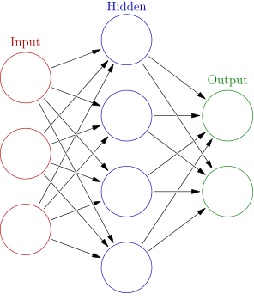
NEURAL NETWORKS

Slide 11
NEURAL NETWORKS
For each hidden layer l

Slide 12
CATEGORIES
Feedforward NN
Trained using backprop:

Slide 13
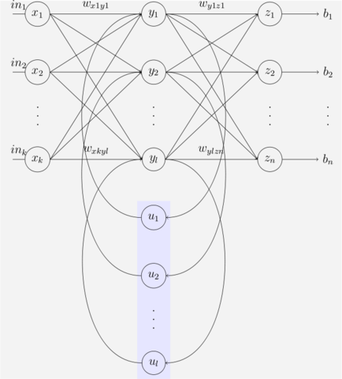
CATEGORIES
Recurrent NN

Slide 14

CATEGORIES
Convolutional NN

Slide 15
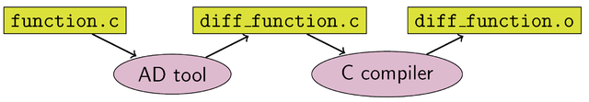
IMPLEMENTATION
Source Code Transformation

Slide 16
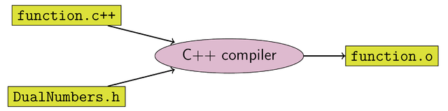
IMPLEMENTATION
Operator Overloading

Slide 17
IMPLEMENTATION
Rationale
Operator Overloading easier to implement given binary nature of operator and parsing of function code.
Intuitively easier to program as Derivative code is appended to normal evaluation code as in-built semantic rules for the parser.
Allows convenient construction of syntax tree. Therefore easier to generate Computational Graph / Evaluation Trace.

Slide 18
IMPLEMENTATION
Codebase design paradigm
Variables – New data type defined for necessary attributes.
Memory – Checkpoint methods for Taping Schemes specific to Neural Networks.

Slide 19
IMPLEMENTATION
Optimisation
Parser based – Performed at compile time alongside other code optimisation.
Reference Count – Repeatedly used variables flagged to decrease memory usage.
Evaluation Sweep – Clearing Trace at appropriate intervals to efficiently utilise memory.
Graph Methods – Vertex Elimination / Matrix Chaining.

Slide 20
SCOPE AND LIMITATIONS
Hessian based Gradient Descent – Second Derivative optimisation algorithms.
Activation Functions – Treat the activation functions of each neural layer as an elementary function.
GPU enhanced Computations – Where Function evaluation can be parallelised, so can AD tool. Devise efficient hybrid sweep schemes.

Slide 21
SCOPE AND LIMITATIONS
High Dimensionality – requires distributed processing
Performace Loss for Basic Network architectures. Hand-Written derivative code more efficient.

Slide 22
CONCLUSION
The techniques discussed above provide guarantees on the reduction of computational complexity and memory efficiency over a general purpose AD tool.
Reduce Prototyping time.
Produce more legible, structured code.

Slide 23
REFERENCES
Recent Advances in Algorithmic Differentiation - Shaun Forth, Paul Hovland, Eric Phipps, Jean Utke, Andrea Walther
Evaluating Derivatives – Andreas Griewank
Automatic differentiation in machine learning: a survey – Baydin et al.
https://en.wikipedia.org/wiki/Automatic_differentiation
https://en.wikipedia.org/wiki/Artificial_neural_network

Slide 24
THANK YOU

